Slide 1
Chapter 1
Overview & backtesting

Slide 2
Overview
There are two main strategies that will be covered in this book:
Mean Reversion
Belief that an asset will revert back to an equilibrium point
Drawn from inter/intraday data of stocks, ETFs vs. their components, currency pairs, futures calendar/intermarket spreads
Backwardation/contango with respect to futures contracts curves
Momentum
Belief that an asset will continue its behavior
4 main drivers of momentum in stocks and futures
Strategies based on news events, sentiment, leveraged ETFs, order flow, and HFT all will be covered in the book

Slide 3
Backtesting and automated execution
Backtesting is done in hopes that the historical performance of a strategy will help us understand what to expect for future performance
The profitability of a strategy (and therefore the effectiveness of a backtest) is extremely sensitive to changes in:
Order Type
The time that the order is placed
Using the bid/ask/last price to trigger a trade
The author of a research paper cannot do out of sample testing within the research paper

Slide 4
Common pitfalls of backtesting
Avoid at all costs

Slide 5
Look-ahead bias
When your algorithm is using information in the future to determine today’s trading signals
Example: using the closing price of today to determine the entry signal for today’s trades
Mitigate by using the same program for backtesting and live trading
Can’t make the same mistake live trading
More common than you think!

Slide 6
Data snooping bias
Caused by overfitting your model based on your training data
May look great when testing but will likely look terrible with test data/OOS testing
If your model doesn’t quite meet your standards, DO NOT TWEAK IT to make it look better
Easiest way to avoid this is to use cross-validation (i.e. use different subsets of the data before using your training data/test data)
Make the model as simple as possible, with as few parameters as possible, and with as few rules as possible

Slide 7
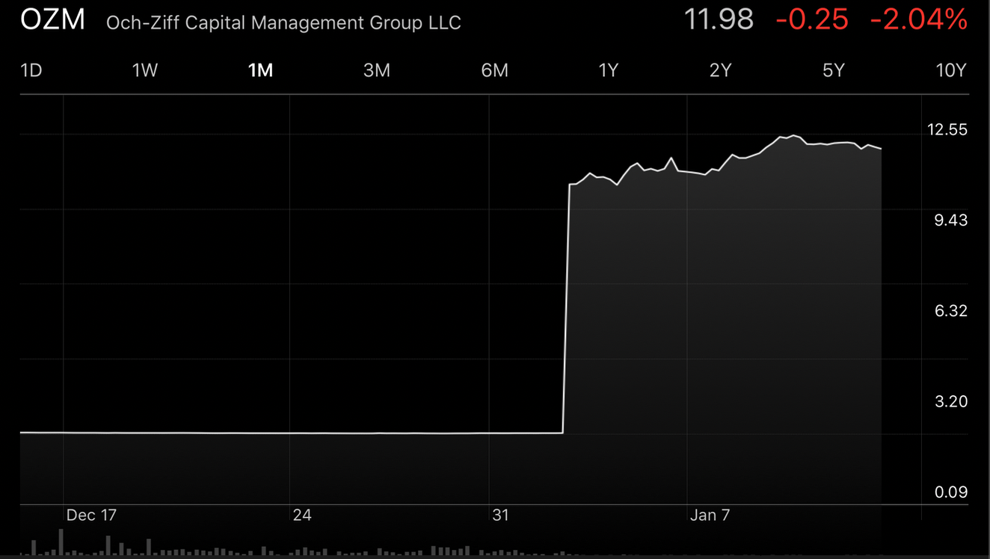
Stock splits and dividends
Some data sources may not account for stock splits and dividends in their price history
Example: look up the 1M chart of $OZM on Apple’s stock app
Usually there is an option on Bloomberg for dividend/split adjustments
Yahoo finance also has dividend and split adjustments (and is free!)

Slide 8
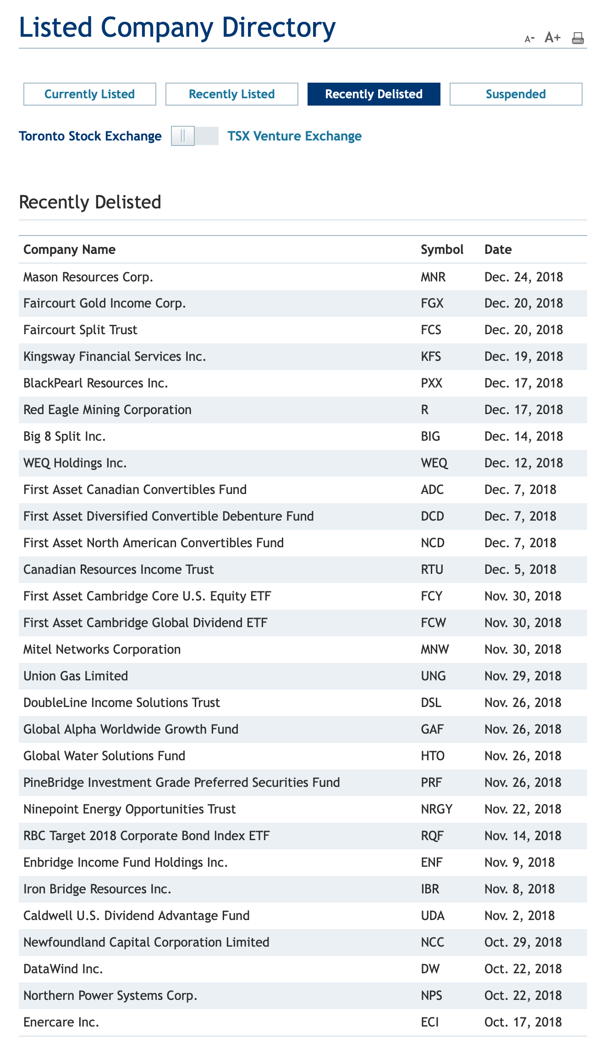
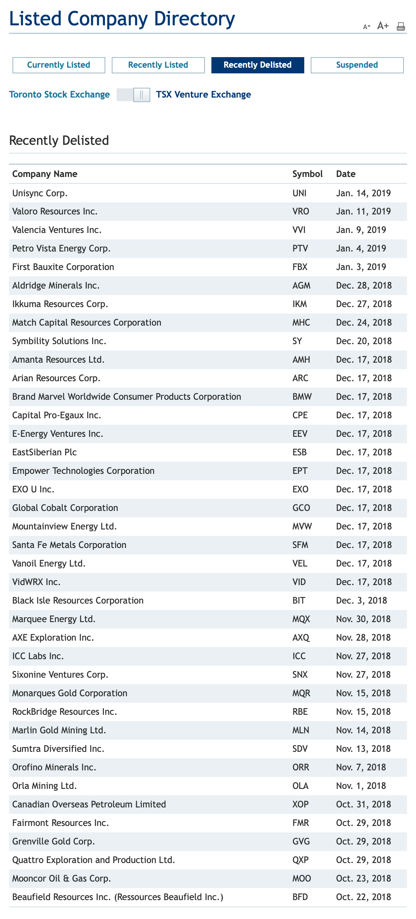
Survivorship bias
Failing to include delisted stocks means that your model will suffer from survivorship bias
Only including stocks that are trading today will give a false bias to your backtest
For example, taking the constituents of the TSX as they are today would mean ignoring all 29 stocks that were delisted in the past 4 months
Or 39 for the TSXV

Slide 9
Venues
The place in which stocks/futures/currencies are traded also affects your backtest
Stock data can be quoted using their primary exchange or using a consolidated dataset
Primary is more useful, prices can fluctuate more widely with the smaller orders that take place on other exchanges
Currency markets are even more fragmented when compared to the stock market
No requirement to trade at the best bid/ask across all venues
Prices and sizes are not generally available without a delay

Slide 10
Short sale constraints
Shorting stock has a few drawbacks
A broker first has to locate the shares you want to short
You have to pay interest on the shares that you are shorting, and that can vary widely depending on short interest/difficulty of finding shares
Small caps are more difficult to short
ETFs are as hard to borrow as stocks
“The $1.5 billion short bet against cannabis stocks is costing $2.4 million a day, or 200 times more than an equivalently sized bet against a basket of stocks including Apple, Amazon, IBM and Goldman Sachs, said Ihor Dusaniwsky, head of predictive analytics at S3 Partners.
” Shorting Cannabis Stocks Is Getting Costly”
https://www.nytimes.com/2018/09/17/business/dealbook/shorting-cannabis-stocks-costly.html

Slide 11
When not to backtest: example 1
The Situation
What’s wrong with it?
A backtest shows an annualized return of 30%
The Sharpe ratio is 0.3
The maximum drawdown duration is two years
High return, low Sharpe is indicative of a fluke strategy
Maximum drawdown is way too long for any sort of investor to have any confidence in the strategy

Slide 12
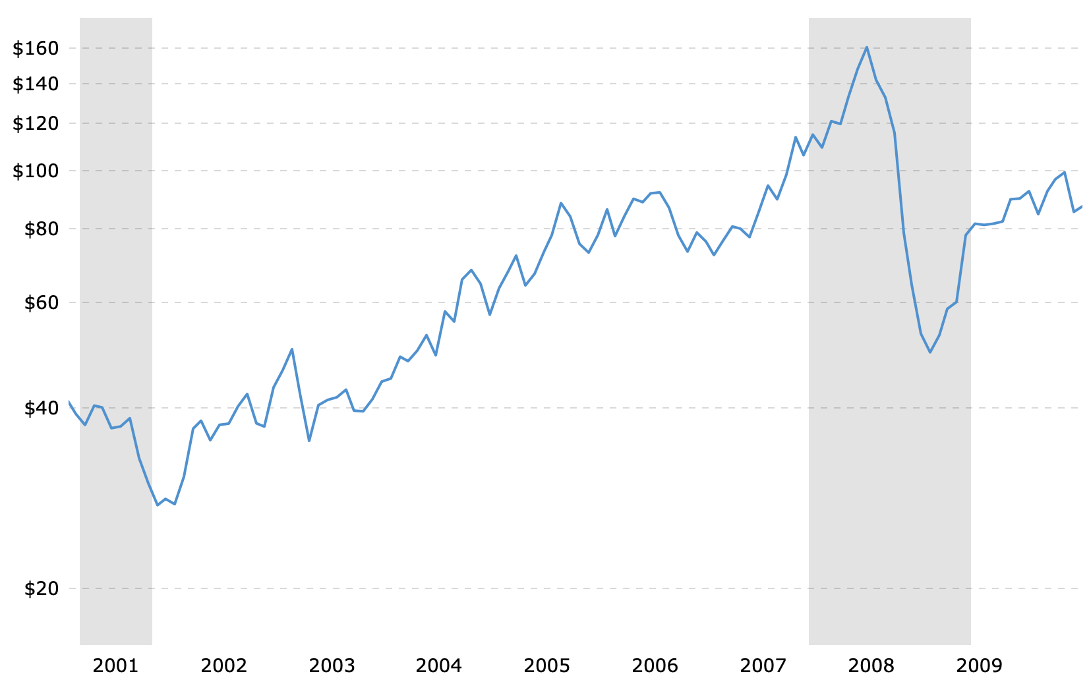
When not to backtest: example 2
The Situation
What’s wrong with it?
A long only crude oil futures strategy returned 20% in 2007
Sharpe ratio of 1.5
Simply holding the front month crude oil futures returned much more than 20% in 2007
This strategy is worse than just buying and holding
Always choose an appropriate benchmark

Slide 13
When not to backtest: example 3
The Situation
What’s wrong with it?
A simple “buy-low-sell-high” strategy picks the 10 lowest priced stocks at the beginning of the year and holds them for a year.
The backtest return in 2001 is 388%
Returns are simply way too high to not be skeptical
If it seems too good to be true, chances are it is
This example had survivorship bias, and when accounting for delisted stocks, the strategy returned -100% in 2001

Slide 14

When not to backtest: example 4
The Situation
What’s wrong with it?
A neural net trading model that has about 100 nodes generates a backtest Sharpe ratio of 6
The words “neural nets” are red flags
100 nodes means that there are at least 100 parameters in the model
Sharpe ratio of 6 helps indicate that the model is overfitted

Slide 15
When not to backtest: example 5
The Situation
What’s wrong with it?
A high-frequency E-mini S&P 500 futures trading strategy has a backtest annual average return of 200 percent and a Sharpe ratio of 6. Its average holding period is 50 seconds.
Backtesting a high-frequency strategy doesn’t really make sense
Placing/executing an order can affect the market, especially in HFT

